Slide 1
Portfolio Executive Committee (PEC)
Review Meeting
Portfolio Overview Update - CREA
  Sarah Liang, Jiaqi Lu | 25th Apr, 2024 | 15 min

Slide 2



Ongoing:
Iclepertin GlyT1 — Cognitive Impairment associated with Schizophrenia (CIAS)
2021 |  | 2022 |  |  |  | 2023 |  |  |  | 2024 |  |  |  | 2025 |  |  |  | 2026 | 2027 | 2028 | 2029 | 2030
H1 | H2 | Q1 | Q2 | Q3 | Q4 | Q1 | Q2 | Q3 | Q4 | Q1 | Q2 | Q3 | Q4 | Q1 | Q2 | Q3 | Q4
today
Global
CONNEX-1 (N=586)
Mar’24
Oct‘24
8Nov24
CONNEX-1 TLR is expected on Nov.18th 2024
NDA-s potentially 2 weeks earlier (final timeline will be released after June HPSC)
Ph3-
1346.11, 12, 13
RoFD
Dec’20
TLR
18Nov24
FPI
LPI
LPO
DBL
April‘24
Nov‘24
Dec’24
TLR
Feb’25
CONNEX-2 (N=586)
FPI
LPI
LPO
DBL
July’24
April‘24
Jan’25
Nov‘24
Dec’24
CONNEX-3 (N=586)
NDA-s
16May’25
NDA-a
Jan’26
FPI
LPI
LPO
DBL
Ph3-
1346.14
Open-label safety extension; treatment duration 12m
Feb’25
Feb‘26
FPI
LPI
LPO
China
NDA-s
Jun’25 (best)
w/PR
NDA-a
Jun’26
wo/PR
NDA-a:
Sep’26
HA consultation for CMC is planned around June 2024. The internal kick-off meeting on 12th Mar 2024
CN PK will be tested locally for CONNEX-1,3 &X to meet timeline. Method transfer is expected to completed at the end of July 2024
TW final randomized 58pts, 1pts gap for non-CPP requirement. Current strategy: submit Non-CPP NDA and response during the review if any
Nomination Chinese investigator for CONNEX manuscript
  Prof. Hongyan Zhang (CONNEX-1)
  Prof. Gang Wang (CONNEX-3, Pooled CONNEX)
Ph3-
1346.11
06Jan’21
CTA + EC + HGRAC + SIV
05Jul
Mar’24
Oct‘24
8Nov’24
Recruitment window: 29m; N=96
TLR
22Nov24
1st SIV
FPI
LPI
LPO
CTA-s
FPI
DBL
Ph3-
1346.13
06Jan’21
CTA + EC + HGRAC + SIV
05Jul
July’24
April‘24
Jan’25
Nov‘24
Dec’24
Recruitment window: 29m; N=178: 120+58 (TW)
CTA-s
1st SIV
FPI
LPI
LPO
DBL
Ph3-
1346.14
01Jun
13Apr’22
Jan’25
Jan’26
CTA Review + EC +
HGRAC + SIV
Open-label safety extension; treatment duration 12m
CTA-s
1st SIV
FPI
LPI
LPO
Notes:
【As of 06Jan2023】
Global 1346.11: FPI on 21Oct2021@US
Global 1346.12: FPI on 28Sep2021@US
Global 1346.13: FPI on 08Sep2021@Korea
Global 1346.14: FPI on 21Mar2022
China 1346.11: FPI on 22Dec2021
China 1346.13: FPI on 20Oct2021
China 1346.14: FPI on 10May2022
【As of 3Apr2023】
Global adjusted CONNEX timeline by additional 9m.

Slide 3
CONNEX recruitment status as of 17Apr 2024
 | CONNEX 1 |  | CONNEX 2 | CONNEX 3
 | Global | China | Global | Global | China | Taiwan*
Total Screened [N] | 853 | 134 | 840 | 845 | 164 | 70
In Screening [N] | 0 | 0 | 0 | 83 | 0 | 0
Screen Failed [N (%)] | 199(24%) | 32(25%) | 229(27%) | 217(26%) | 32(21%) | 12(17%)
Randomised (actual VS. initial plan) | 620(a) VS. 586(p) | 96(a) VS. 88(p) | 611(a) VS. 586(p) | 545(a)VS. 586(p) | 120(a) VS. 62(p) | 58(a) VS. 40(p)
Discontinued [N (%)] | 76(12%) | 9(9%) | 61(10%) | 63(12%) | 8(7%) | 3(6%)
Completed [N] | 363 | 71 | 351 | 322 | 99 | 38
Estimated Percentage (%)/Global randomization | / | 15.5% | / | / | 20% | 10%
* updated by 24Apr2024

Slide 4
1346-0014 rollover study China and Taiwan recruitment summary _cutoff date 17Apr2024
 | China | Taiwan
Rolled over(p) | 175 | 50
Rolled over(a) | 126 patients rolled over (rollover rate 126/170=74%) | 35 patients rolled over
Discontinued Treatment Early | 10 (8%) | 3 (8.6%)
Completed Treatment | 49 | 15

Slide 5
CONNEX Global & Local CIAS Publication Plan
US LAUNCH
Q1 2026
2024
2025
2026
Q1
Q2
Q3
Q4
Q4
Q1
Q2
Q3
Q1
Q2
Q3
Q4
1346-0011 Ph III CONNEX 1
Ps
Ph III CONNEX Pooled Efficacy
1346-0011 Ph III CONNEX 1 Post Hoc Analysis
1346-0013 Ph III CONNEX 3 Post Hoc Analysis
Ps
Ps
Ps
Manuscripts
1346-0011 Ph III CONNEX 2
Ph III CONNEX Pooled Safety
1346-0014 Ph III CONNEX X
1346-0014 Ph III CONNEX X Post Hoc Analysis
Ps
Ps
Ps
Ps
1346-0013 Ph III CONNEX 3
1346-0012 Ph III CONNEX 2 Post Hoc Analysis
Ps
Ps
1
2
Will further evaluate nominations internally and communicate with Prof. Wang prior to proposed to global
CIAS review in Chinese SCZ
CONNEX TLR [CSP 2025]
CHINA
Early phase data encores [CSP 2024]
Ph III CONNEX Asian/Chinese (Efficacy + Safety)
3
Will ask global support that CN to lead these publications (CN first author)
Congress abstract
Manuscripts
Other local ECRs and IIS publications
Nomination Chinese investigator for CONNEX manuscript
Category | Status | Publication | Name | Institution | Note
 | Proposed to Global on April 19th | CONNEX-1 | Hongyan Zhang | Sixth Hospital of Peking University | CONNEX-1 Leading PI
 |  | CONNEX-3 | Gang Wang | Beijing Anding Hospital | National coordinator CONNEX-3 Leading PI CONNEX-X Leading PI
 |  | Pooled CONNEX | Gang Wang
1

Slide 6
One Page Summary ━ CREA (CNS)
TA | Ongoing |  | Endorsed | Under evaluation | Next wave
CREA | Iclepertin (GlyT1) CIAS – Ph3 |  | BI 1358894 (TRPC4/5) PTSD – Ph3 | CT-155 (DTx) Negative symptom of Schizophrenia | BIBF 1120 (Nintedanib IVT (TKi) / wAMD
 | Metalyse (TNK) AIS – Ph3 |  | BI 1358894 (TRPC4/5) MDD – Ph3 Ph2 TLR: Efficacy - failed to separate from placebo on MADRS change from baseline at Week 6 AT to propose Asset Termination in Apr’s HPSC | BI 1815368 (PKKi) wAMD prevention - CN: Ph2 | BI 3031185 (mGluR4 NAM) / Impulsivity
 | BI 1569912 (NR2B NAM) MDD adjunct– Ph2 (FOT) |  | BI 764524 (anti-SEMA 3A) DR – CN: Ph3 | BI 1584862 (PAFR antagonist) GA – CN: Ph2. | Iclepertin (GlyT1) / LAI for CIAS PMO
 |  |  |  | BI 771716 (anti-C3) GA– CN: Ph2/Ph3 | BI 3776528 (SSTR4 ago.) / CI PSD (Cognitive Impairment in Psychosis Spectrum Disorders)
 |  |  |  | BI 1356225 (GOATi) Impulsivity in Substance Use Disorder | CT-156 (DTx) / Schizophrenia (functioning)
 |  |  |  |  | BI 3793898 (mGluR3 PAM) / CIAS
On track
Timeline: 1-3 months delay or potential delay;
Strategic issue: global strategy uncertain; China integration/development at risk, insufficient China sample size;
Operational issue: slow enrollment, compliance rate lower than plan;
Regulatory issue: technical and/or dossier issues and/or deficiency letter with potential impact to approval and/or approval timeline;
Quality: 3 major site audit observations, inspection readiness with significant issues; major NC report
Timeline: > 3 months delay
Strategic issue: project to be terminated, China integration/development undermined;
Operational issue: major enrollment delay, significant poor compliance;
Regulatory issue: negative comment from authority, major concerns due to regulation change;
Not meeting primary end point;
Quality: ≥ 1 critical and/or ≥ 4 major site audit observations; inspection readiness with critical issues; critical NC report
Notes:
Predefined PoCP criterion for aNrp-1 not met​
Deep analysis of the data did not reveal any treatment impact on Retinal Non-Perfusion​
Further activities for aNrp-1 in DR are not recommended​
aNrp-1 did not show preclinically neuroprotective activity: no alternative development scenario in RH​

Slide 7
Ongoing:
BI 1569912 (NR2B NAM) — Major Depressive Disorder (MDD) adjunct
2022 |  |  |  | 2023 |  |  |  | 2024 |  |  |  | 2025 |  | 2025 |  | 2026 |  | 2027 | 2027 | 2028 | 2029
Q1 | Q2 | Q3 | Q4 | Q1 | Q2 | Q3 | Q4 | Q1 | Q2 | Q3 | Q4 | Q1 | Q2 | Q3 | Q4 | H1 | H2 | H1 | H2
today
Global
MutaMouse study positive to lift clinical hold
Oct’22
Sep’23
Ph1 MRD
1447.2
MRD in HV (N=60)
FPI
LPO
PoCP
Feb’24
Ph1b-1447.3
Nov’22
Aug’23
PoCP trial (N=66)
FPI
LPO
TLR
Jan’24
US FPI on 27Mar2024
Ph1-1447.4
Sep
Feb
Sep
Nov
JP Ph1 (SRD)
MD (20mg)
FOT: IQVIA
FPI
LPO
FPI
LPO
Ph2-1447.5
Mar’24
Sep’25
US NDA-a:
Mar 2030
Ph2 trial (N=204)
CTP/ICF
Dec’23
FPI
LPI
China
FOT: IQVIA
20Dec’23
Q2/3 ’24
Sep’25
Ph2-1447.5
wo/pre-IND
CTA Review + EC + HGRAC + 1st SIV
Ph2 (N=16)
CH NDA-a:
Nov 2030
CTA-s
1st SIV
LPI
It’s obtained the EC approval from leading site on 23rd Apr 2024.
China submitted the CTA as the 1st submission in global on 20th Dec 2023, and received the formal CTA approval on 11th Mar 2024.
China has been allocated for 16 patients with 10 sites.
China Leading PI is Prof. Li Huafang from 上海市精神卫生中心.

Slide 8
NR2B NAM PoCP Study Design
Study design
Study schematic
MDD patients with inadequate response to ≥1 antidepressant in current episode
Single administration of BI 1569912 (20 mg or 5 mg), or placebo; adjunct to ongoing SSRI / SNRI therapy
Primary endpoint is safety and tolerability; max decrease in MADRS within 7 days
Dissociation assessed by CADSS, B-VAS, SMWQ
Optional 6-w lead-in phase
with SSRI/SNRI
20 mg n= 20 single admin.
S
R
5 mg n= 20 single admin.
Placebo n= 19 single admin.
Screening
in-patient
out-patient (follow-up)
Day 1
Day 2
Day 4
Day 6
Day 8
Day 11
Day 15
PoCP criteria: Improvement in MADRS total score compared to placebo ≥3 at one time point and ≥2 at a neighboring time point in either dose

Slide 9
Safety and tolerability on treatment and follow up
System organ class/Preferred term | Placebo |  | BI 1569912 5 mg |  | BI 1569912 20 mg
Preferred term | N | % | N | % | N | %
Number of patients | 19 | 100.0 | 20 | 100.0 | 20 | 100.0
Patients with any AE | 6 | 31.6 | 7 | 35.0 | 3 | 15.0
Patients with severe AEs | 0 | 0.0 | 0 | 0.0 | 0 | 0.0
Patients with AEs of special interest | 0 | 0.0 | 0 | 0.0 | 0 | 0.0
Patients with serious AEs | 0 | 0.0 | 0 | 0.0 | 0 | 0.0
Patients with investigator defined drug-related AEs:¹ | 1 | 5.3 | 3 | 15.0 | 1 | 5.0
Gastrointestinal disorders | 0 | 0.0 | 2 | 10.0 | 0 | 0.0
Investigations (increased blood pressure) | 0 | 0.0 | 1 | 5.0 | 0 | 0.0
Metabolism and nutrition disorders | 1 | 5.3 | 0 | 0.0 | 1 | 5.0
Nervous system disorders | 1 | 5.3 | 1 | 5.0 | 0 | 0.0
Psychiatric disorders | 1 | 5.3 | 0 | 0.0 | 0 | 0.0
Skin and subcutaneous tissue disorders | 0 | 0.0 | 0 | 0.0 | 1 | 5.0
BI 1569912 was safe and well-tolerated, with a comparable amounts of adverse events compared to placebo.
No clinically relevant changes on group level for blood pressure and for notable findings in the ECG were observed.
Percentages are calculated using total number of subjects per treatment as the denominator. MedDRA version used for reporting: 26.1
1 Primary safety endpoint

Slide 10
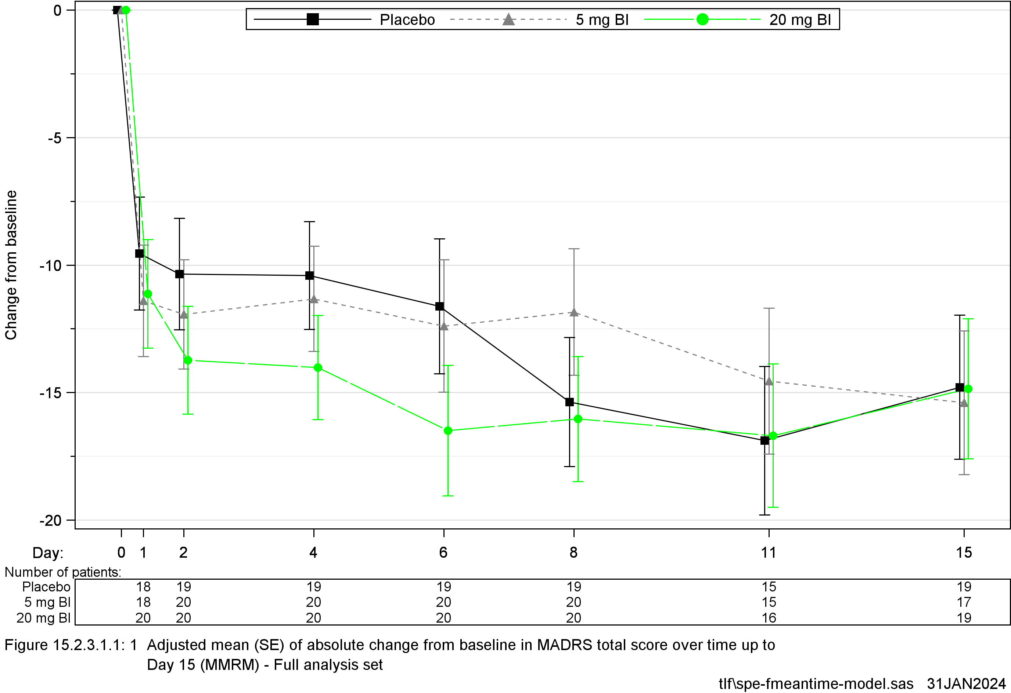
BI 1569912 20 mg demonstrated rapid onset, sustained for five days post-administration
Between 3.4 and 4.9 point improvement from Day 2-Day 6 after single administration (PoCP criteria was ≥3 points at one time point and ≥2 points at a neighboring time point in either dose)

Slide 11
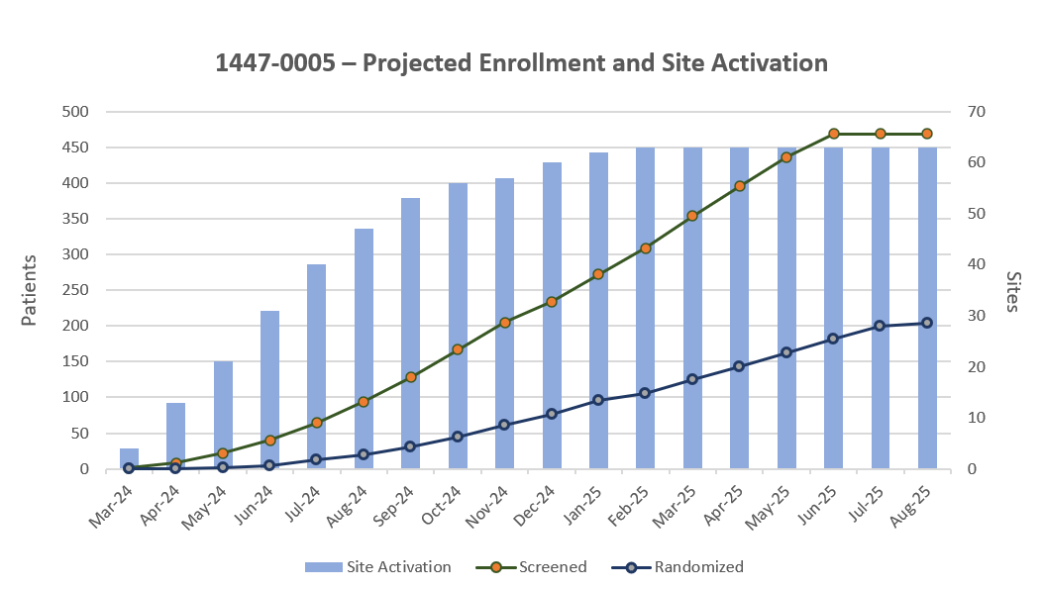
Lead indication: Aspiration & development strategy
From HPSC
MDD adjunct PoCC key study assumptions and timelines
Key assumptions
Screened | 469
Randomized | 204
Screen Failure Rate | 55% (average)
Crude recruitment rate (FSS-EoS) | 0.17
Net recruitment rate | 0.30
Enrollment Duration | 16 months
Drop Out Rate | 15%
Total Countries/Sites | 7/63
Key milestones
First Subject Screened | 20-Mar-2024
75% site activation | 27-Sept-2024
Last Subject Randomized | 5-Sep-2025
Last Subject Completed (End of study) | 31-Oct-2025
Database Lock | 12-Dec-2025
Topline Results | 16-Jan-2026
We are assuming an ambitious 0.3 nRR and 75% site activation within six months. For reference, TRPC4/5 MDD averaged ~0.17 nRR post-COVID

Slide 12
NR2B asset maximization scenarios
New indication SODs
Ph2a signal-finding study
Ph2b dose-range finding study
Ph3 studies
Proposed scenario
 | 2024 | 2025 | 2026 | 2027 | 2028 | 2029 | 2030 | 2031 | 2032 | 2033 | 2034 | 2035 | 2036 | 2037 | 2038 | 2039
Explore now
Depression now, expand later
Focus on MDD
Key considerations
MDD adj
MDD mono + adj
NDA
US approval
Assess full potential of asset ASAP – can decide to pivot to high unmet need indications if desired
PTSD and OCD studies are derisked with seamless phase 2a / 2b design e.g., ~10M EUR at risk for each
MDD mono
1
NiSOD
BD
BD
US approval
PTSD
PTSD
NDA
US approval
NiSOD
PIND
OCD
OCD
NDA
US approval
NiSOD
PIND
NDA
MDD adj
MDD mono + adj
NDA
US approval
Assess potential in depression ASAP where we have highest confidence
Derisk expansion investment in PTSD and OCD with PoCC in MDD adj e.g., ~10M EUR at risk for each
2
MDD mono
NiSOD
BD
BD
NDA
US approval
PTSD
PTSD
NDA
US approval
NiSOD
PIND
OCD
OCD
US approval
PIND
NDA
NiSOD
MDD adj
MDD mono + adj
NDA
US approval
Focus on highest value opportunity: MDD
Initiate development for other indications once MDD pivotal studies are kicked off – as to not distract team during intense period of Ph2-Ph3 transition for MDD
MDD mono
3
BD
BD
US approval
NiSOD
PTSD
PTSD
NDA
NiSOD
PIND
NDA
US approval
OCD
OCD
US approval
NiSOD
PoCC achieved in MDD adjunct
IRA pricing in effect
Note: Timelines shown are illustrative pending further diligence; submissions may have to be delayed pending prior submission approval; Long term studies not shown for clarity

Slide 13
NR2B NAM high level program timeline
Aug 16
Nov 30
May 1
Jul 28
May 11
Jan 31
Jun 11
Jan 8
Mar 1
1043 days
485 days
569 days
570 days
370 days
126 days
344 days
570 days
570 days
233 days
116 days
116 days
131 days
262 days
707 days
953 days
262 days
138 days
496 days
Feb 20
Feb 20
Jan 31
Jul 28
Jan 23
Dec 1
2024
Today
2032
today
FSS
Key Results
2024
2025
2026
2027
2028
2029
2030
2031
2032
PoCP
Sep 1 - Jan 30
1447-0005; Ph II DRF; MDD adj.
PoCC
HPSC RoFD
NDA
JNDA/SNDA
MAA
Ph II DRF; MDD mono
PoCC
Oct 25 - Dec 31
Oct 25 - Dec 31
Appr. US
Appr. JP
Appr. CN
Appr. EU
MDD
mono + adj
Oct 25 - Dec 31
Feb 28 - Jan 7
Short term efficacy - adjunct
Indication
Oct 25 - Jul 10
Short term efficacy - mono
Dec 7 - Feb 11
Oct 25 - Jun 19
Short-term efficacy – vs vortioxetine (DBL to week 6 for US, JPN; OL to week 26 for G-BA)
Mar 8 - Jan 30
Long-term open label extension
Randomized withdrawal study – 26 weeks
BD Depr.
niSoD
1447-0014 - Ph II DRF
PoCC
Ph III program
NDA
Approval US
May 13 - Nov 4
1447-0007: DDI induction potential of CYP2B6 & CYP3A4
1447-0010; Human ADME/Absolute BA
Oct 15 - Feb 8
Clinical supporting studies
1447-0006: DDI victim of CYP2J2 inhibition
Hepatic impairment
Sep 19 - Aug 11
Jul 22 - Jan 29
Renal impairment
non-clinical abuse potential studies
Oct 25 - Apr 5
NDS
Longterm tox (26w/39w) rat/dog
Oct 25 - Apr 5
Carcinogenicity Studies
Dec 18 - Jun 18
CMC
Development iCF solid oral
Dec 31 - Dec 28
Process development & scale-up
Apr 24 - Apr 24
Apr 24 - Apr 24

Slide 14
Summary of Leading PIs on PTSD & MDD in China
Study - ongoing | PI | Site
CONNEX-1 1346.11 | 张鸿燕 | 北京大学第六医院
CONNEX-1 1346.13 | 王刚 | 首都医科大学附属北京安定医院
CONNEX-1 1346.14 | 王刚 | 首都医科大学附属北京安定医院
Study – planned | PI proposal | Site
TRPC 4/5 MDD Ph3 *3 studies (single dose* vs placebo) | 王刚 | 北京大学第六医院
 | 李华芳 | 上海市精神卫生中心
 | 张鸿燕 | 北京大学第六医院
TRPC 4/5 PTSD ph3 *2 studies (single dose vs placebo/ 2 doses vs placebo) | 王刚 | 北京大学第六医院
 | 王振 | 上海市精神卫生中心
 | 于欣 | 北京大学第六医院
 | 李凌江 | 中南大学湘雅第二医院
TRPC 4/5 PTSD ph1 | 李华芳 | 上海市精神卫生中心
NR2B MDD Ph2 | 李华芳 | 上海市精神卫生中心

Slide 15
Under evaluation:
CT-155 Digital Therapeutics — Negative Symptom of Schizophrenia
2022 |  |  |  | 2023 |  |  |  | 2024 |  |  |  | 2025 |  |  |  | 2026 |  |  |  | 2027 |  | 2028 | 2029
Q1 | Q2 | Q3 | Q4 | Q1 | Q2 | Q3 | Q4 | Q1 | Q2 | Q3 | Q4 | Q1 | Q2 | Q3 | Q4 | Q1 | Q2 | Q3 | Q4 | H1 | H2
today
Global
Clinical learning studies
CLS 1
CLS 3
CLS 2
RoFD
27Jan’23
31Mar’23
Due to the RCT recruitment challenges, the project timeline was re-based in Feb’s HPSC.
RCT in US (Convoke trial)
Pivotal trial
TLR
Jul’24
Mar’25
US Sub*
Oct’24
Aug’25
US Appr
Apr’25
Jan’26
FPI
China
NMPA
consultation
All regions have NO any centric activities planned before TLR released by Mar 2025.
1
w/o China RCT*
- Preferred
Localization (6m, tbc)
Device testing (3m)
* Overseas data + ethnic difference analysis + RWE
NDA-s
Mar’26
NDA-a
Mar’27
Scenarios
2
Localization (6m, tbc)
RCT in China
- Not preferred
Q3’25
Q2‘26
Pre-IND
CTA+EC+HGRAC+1st SIV (6M)
RCT in China
Device testing
NDA-s
H1’27
NDA-a
H1’28
CTA-s
FPI
Notes:
Type III App myPKFiT® (Takeda) via Priority Review:
NDA-s: before 15 Mar 2019
NDA-a: 17 Nov 2020

Slide 16
CT-156 Study planning: focusing on functional impairment - including medication adherence – in people living with Schizophrenia
CLS1 completed
CLS2 FPI May 6, LPO Dec 9
TLR
RCT FPI Apr 2025
US Appr
Aug 2028
CLS1 (Clinical Learning Study) TLR: enhances confidence that the CT-156 approach effectively engages participants
CLS2: Under preparation
RCT FPI projected for Apr 2025

Slide 17
One Page Summary ━ CREA (Retinal Health)
TA | Ongoing |  | Endorsed | Under evaluation | Next wave
CREA | Iclepertin (GlyT1) CIAS – Ph3 |  | BI 1358894 (TRPC4/5) PTSD – Ph3 | CT-155 (DTx) Negative symptom of Schizophrenia | BIBF 1120 (Nintedanib IVT (TKi) / wAMD
 | Metalyse (TNK) AIS – Ph3 |  | BI 1358894 (TRPC4/5) MDD – Ph3 Ph2 TLR: Efficacy - failed to separate from placebo on MADRS change from baseline at Week 6 AT to propose Asset Termination in Apr’s HPSC | BI 1815368 (PKKi) wAMD prevention - CN: Ph2 | BI 3031185 (mGluR4 NAM) / Impulsivity
 | BI 1569912 (NR2B NAM) MDD adjunct– Ph2 (FOT) |  | BI 764524 (anti-SEMA 3A) DR – CN: Ph3 | BI 1584862 (PAFR antagonist) GA – CN: Ph2. TALC endorsed that the Ph2 PoCP/PoCC study will be only run in US for the budget saving focus. | Iclepertin (GlyT1) / LAI for CIAS PMO
 |  |  |  | BI 771716 (anti-C3) GA– CN: Ph2/Ph3 The Asian strategy is under discussion, but Ph2 will be only run in US as same as PAFR. | BI 3776528 (SSTR4 ago.) / CI PSD (Cognitive Impairment in Psychosis Spectrum Disorders)
 |  |  |  | BI 1356225 (GOATi) Impulsivity in Substance Use Disorder | CT-156 (DTx) / Schizophrenia (functioning)
 |  |  |  |  | BI 3793898 (mGluR3 PAM) / CIAS
On track
Timeline: 1-3 months delay or potential delay;
Strategic issue: global strategy uncertain; China integration/development at risk, insufficient China sample size;
Operational issue: slow enrollment, compliance rate lower than plan;
Regulatory issue: technical and/or dossier issues and/or deficiency letter with potential impact to approval and/or approval timeline;
Quality: 3 major site audit observations, inspection readiness with significant issues; major NC report
Timeline: > 3 months delay
Strategic issue: project to be terminated, China integration/development undermined;
Operational issue: major enrollment delay, significant poor compliance;
Regulatory issue: negative comment from authority, major concerns due to regulation change;
Not meeting primary end point;
Quality: ≥ 1 critical and/or ≥ 4 major site audit observations; inspection readiness with critical issues; critical NC report
Notes:
Predefined PoCP criterion for aNrp-1 not met​
Deep analysis of the data did not reveal any treatment impact on Retinal Non-Perfusion​
Further activities for aNrp-1 in DR are not recommended​
aNrp-1 did not show preclinically neuroprotective activity: no alternative development scenario in RH​

Slide 18
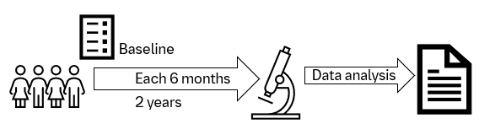
China GA ECR
Fill the data gap of disease phenotypes, progression rate and potential predictor biomarkers in China, thus enlighten the GA development strategy in China and Asia
PART A：Cross-sectional
N=100~150
Data of the first visit
Objective:
Description of BCVA and GA lesion involvement of fovea
Multimodal imaging features and phenotypes
PART B：Prospective cohort
N=50
Observation period: 2 years
Objective：
The change of GA lesion size and progression rate of lesion after 2 years
The change of BCVA and GA lesion involvement of fovea after 2 years
* Partner with Prof Chen Youxin from Peking Union hospital leading 6 centers

Slide 19
China Evidence Generation Strategy for GA Disease Area
2024 | 2025 | 2026 | 2027 | 2028 | 2029 | 2030
PAFR PhII in US Q1 2025-Q1 2027
PAFR PhIII Q1 2028- 2031
POCP
Anti-C3 Ph II in US Feb 2025-Jan 2027
Anti-C3 Ph III Apr 2027- Apr 2030
(Acceleration Scenario)
POCP
Anti-C3 pan-Asian Ph1 (TBD)
ECR protocol finalization + IRB approval July 2024
Provide progression rate and phenotype data to support China Ph3
20-25%€
Data collection and analysis
Dec 2026
70-80%€
CTR
Feb 2027
Interim analysis
Jan 2026
100%€

Slide 20

Endorsed:
BI 764524 (aSema3A)– Non-Perfusion Diabetic Retinopathy (NPDR)
today
2022 |  | 2023 |  |  |  | 2024 |  | 2025 |  | 2025 |  |  |  | 2026 |  |  |  | 2027 | 2028 | 2029 | 2030 | 2031
H1 | H2 | Q1 | Q2 | Q3 | Q4 | Q1 | Q2 | Q3 | Q4 | Q1 | Q2 | Q3 | Q4 | Q1 | Q2 | Q3 | Q4
Global
1436.2: non-interventional
Jun’22
Eye-EMI, N=650
Ph1/2a completed for both aSema3A & aNRP1
Data analysis ongoing, TLR of anti-SEMA 3A available at end of Jun’23
TDO for Phase IIb close to finalization
PMDA agreed the SRI strategy before Ph2b. FDA disagreed to use Sham in Ph3 and not recommend for Ph2.
LPI
29Sep’20
25Nov’22
26Apr’23
aSema3A
1436.1 Ph1/Ph2a
PoCP
mid-Jul’23
FPI
LPI
LPO
Mar’24
Mar’25
Jul’26
Post-PoCP trials
Ph2b (N=120~150), recruitment window (12 m); trt (52 wk); off-trt (26 wk)
Phase 3
Launch
2030
FPI
LPI
LPO
IA
FOT: ORA
Japan
PMDA mtg
Jul’23
China
Jun
15Jul’22
1436.2: non-interventional
Eye-EMI, N=650
LPI
LPI extended
Post-PoCP trials
China integration into Ph2b was NOT supported by the Asset Team. To keep the variability and complexity (and cost) low, Ph2b will focus on limited countries. It was suggested by the Asset Team to look into ECR opportunities and pave the way for Ph3.
Phase 3

Slide 21
Under evaluation:
BI 1815368 FR (PKKi) — wAMD prevention
today
2022 |  |  |  | 2023 |  |  |  | 2024 |  |  |  | 2025 |  | 2025 |  | 2026 |  |  |  | 2027 |  |  |  | 2028 | 2029 | 2030 | 2031 | 2032
Q1 | Q2 | Q3 | Q4 | Q1 | Q2 | Q3 | Q4 | Q1 | Q2 | Q3 | Q4 | Q1 | Q2 | Q3 | Q4 | Q1 | Q2 | Q3 | Q4 | Q1 | Q2 | Q3 | Q4
17Jun
4Nov’22
19Jun
05Jan’24
FOT: ORA
Ph1: 1485.1 & 2
SRD & MRD
SRD
MRD
FSS
LSC
TLR
Mar’24
Jan’25
2027
Phase IIa & IIb (to be updated)
Ph2: 1485.4
PoCP
Q3 2024
FSS
LSC
Ph3: 1485.7 & 8
Q3’27
2030
Dec’24
Phase III * 2
Sep’24
Japan Ph1: 1485.5
J-Ph1
JP Ph1 dependent on PoCP
FSS
LSC
NDA-a
Oct‘31
CTN-s
Apr’24
FSI
LSC
DBL
Dec’24
JP Ph1 postponed to Jun 2024 (originally Mar’24) due to the delay of Ph2 by 3m. TLR expected in Sep’24. But JP team plans to submit CTN in Jan’24 to keep the opportunity for early initiation of JP Ph1.
China
mid-Nov‘24
May’25
2027
Ph2: 1485.6
wo/pre-IND scenario:
CTA + EC + HGRAC + 1st SIV (6m)
Phase IIa & IIb (to be updated)
CTA-s
1st SIV
LSC
Ph3: 1485.7/8
Q3‘27
2030
Feedback post ARVO about DME: CSFT would be a reasonable PoCC endpoint, and 3 months is seen a reasonable timeframe to get CSFT responses. Interaction w/ FDA was recommended to take place once ph2 data is available. TPP change to DME without VA impairment and compare to observation was recommended (in line with ARVO feedback).
Phase III
NDA-a
Nov‘31
FSS
LSC

Slide 22
Thank You !

Slide 23

Ongoing:
BI 1358894 (TRPC4/5) — Post Traumatic Stress Disorder (PTSD)
today
2022 | 2022 | 2023 |  |  |  | 2024 |  |  |  | 2025 |  | 2025 |  | 2026 |  | 2027 | 2027 | 2028 |  | 2029 |  | 2030 | 2031
H1 | H2 | Q1 | Q2 | Q3 | Q4 | Q1 | Q2 | Q3 | Q4 | Q1 | Q2 | Q3 | Q4 | H1 | H2 | H1 | H2 | H1 | H2 | H1 | H2
Global
02Feb’22
Oct
Ph2-1402.30
Mar’23
Jul
N=266
RoFD
Jun’24
FPI
IA
LPI
LPO
Oct’24
TBD
Ph3-1402.31/32/33
TLR
04Dec’23
Ph3 short-term pivotal trials, N=TBD
US NDA-s
May 2028
US NDA-a
Mar2029
EOPII MR-s
Mar’24
FDA mtg
May’24
FPI
LPO
Ph3-1402.32
To give more insights from TRPC4/5 PTSD PoCC study in Feb 2024’s HPSC as below summary：
- There is insufficient consistent strong evidence from 1402-0030 to generate high confidence in a clinically relevant impact of the compound at this dose and with this posology in patients with PTSD
TBD
TBD
Ph3 CTP
Jun-Jul’24
Ph3 long-term pivotal trial, N=TBD
FPI
LPO
China
Jul’24
Jan’25
Ph3-
1402.31/32/33
CTA Review + EC + HGRAC + 1st SIV (6M)
Recruitment window TBD
NDA-s
Jun 2028
NDA-a
Dec 2029
Pre-IND MR-s
Mar‘24
CTA-s
FPI
CN PK-
1402.XX
To try join Ph3 directly in pre-IND (low PoS). If CDE disagrees, then:
Recruitment Window: TBD

